Slide 1
Break Bricks
Using JavaScript

Slide 2
Presentation Overview
Project Idea
Project Structure
Game
Game Progression
Tracking
Colour Picker
Voice Recognition

Slide 3
Project Idea
The project is based on an old game called Break Bricks which is a game of strategy not a test of speed or quick thinking. The object of Brick Break is to remove all colour bricks from the game field to proceed to next level.
My idea was to develop my own version of that game and add gesture colour tracking (at the beginning) to:
To control the paddle.
Pick level.
Start & pause the game.
However…

Slide 4
Project Idea Continued…
During the development of the project colour recognition seemed a little too simplistic and did not give much satisfaction of gesture a-like controls.
Instead, I decided to:
Use hand tracking for paddle movement.
Voice recognition to control the menu aspects of the game.

Slide 5
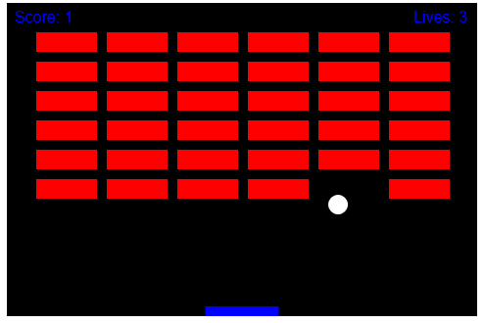
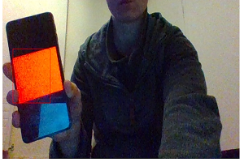
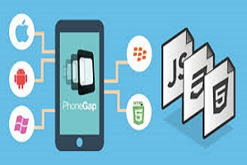
Project Structure – First Idea
Game
Tracking
Colour Picker
Game is made using HTML Canvas feature.
Tracking is done by using tracking.js library.
Colour picker will be developed using PhoneGap.

Slide 6
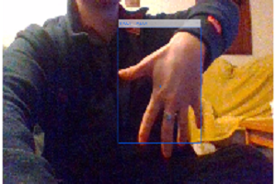

Project Structure – Second Idea
Game
Tracking
Voice Recognition
Game is made using HTML Canvas feature.
Tracking is done by usage handtrack.js library.
Voice recognition is done by usage of Web Speech API.

Slide 7
Game
Game will be basic replication of the original.
Game will have three stages:
Play.
Pause.
Quit.
At the top of the screen there will be two statistics present:
Lives.
Score.

Slide 8
Game Progression
Player will have three lives.
Once used up, the game is over.
Upon passing the level, start screen will be present again.
Where user will be able to repeat the level or choose a different one.
Upon win or lose scenario
Score will be present to the user.

Slide 9
Tracking – First Idea
Tracking is done by usage of tracking.js.
‘The tracking.js library brings different computer vision algorithms and techniques into the browser environment. By using modern HTML5 specifications, we enable you to do real-time color tracking, face detection and much more — all that with a lightweight core (~7 KB) and intuitive interface.’ - trackingjs.com
A modern approach for Computer Vision on the web.
User will need to allow access to the webcam.
To avail colour detection.
Considered using hand tracking instead of colour tracking.
Still considering this as an option.

Slide 10
Tracking – Second Idea
Tracking is done by usage of handtrack.js.
‘Handtrack.js is a library for prototyping realtime hand detection (bounding box), directly in the browser. Underneath, it uses a trained convolutional neural network that provides bounding box predictions for the location of hands in an image. ’ – victordibia.
User will need to allow access to the webcam.
To avail hand tracking.

Slide 11
Colour Picker – First Idea
Colour picker will be stored on a mobile device.
This will be done using PhoneGap
PhoneGap – ‘Easily create apps using the web technologies you know and love: HTML, CSS, and JavaScript.’ - phonegap.com
Mobile device will serve as a gesture controller
User will pick colour.
Each colour will serve different action.
For example: Blue will move the paddle.

Slide 12
Voice Recognition – Second Idea
Voice recognition is done by usage of Web Speech API.
‘The Web Speech API enables you to incorporate voice data into web apps. The Web Speech API has two parts: SpeechSynthesis (Text-to-Speech), and SpeechRecognition (Asynchronous Speech Recognition.)’ - https://developer.mozilla.org/en-US/docs/Web/API/Web_Speech_API.
…where I’m only focused on SpeechRecognition.
Menu aspects of the game will be controlled with voice control.
Upon recognising the correct phrase (from collection of phrases) program will transition player from one part of the game to the other:
Menu to the game.
Pause to Play.
Play to Pause, etc.

Slide 13
Questions?

